Slide 1
Kerry O’Hare
Student Engagement Officer 2012 - 2022

Slide 2
Issues affecting engagement with their studies, union societies, student support or the wider university life
How this lack of engagement is impacting upon the student.
What is the student’s perspective on this issue, what could be done differently?

Slide 3
The Mature Student Project 2018
WHY: I am a mature student myself. I am aware of certain support services within the university; however I am also aware that I have been ‘forgotten’ as a mature student. Why are certain mature students not targeted by the Mature Student Society? I would like to see if we can stop students ‘falling through the net’.
AIMS: This project has two aims
Gather from the mature students how they feel about being a ‘mature student’ and the positives and negatives of their experiences and whether they are aware of certain support services.
The second is to see if these services are functioning correctly and if not, how can we fix this so students are not feeling ‘isolated’ nor a ‘part of the university’.

Slide 4
Data collection
Locate the mature students who had left the university within their first year The university classifies a ‘mature’ student as anyone aged over 21.
There was 16 students who had terminated their studies from September 2017.There was 9 males and 7 females aged between 21 and 59 studying a variety of degree courses at level 4.
Literature review, Survey Monkey, interviews. Registry exit data, disability codes, polar data and the social media Facebook page.

Slide 5
Data collection
Facebook group discussion with mature students to determine the following:
➢ First term experiences of being a mature student
➢ Whether they are aware of support
➢ Whether they feel supported
➢ Whether they were acknowledged as a mature student or felt overlooked
➢ Whether they received any communication from the university
➢ Any suggestions they would like to propose to ensure the ‘Mature Student Experience’ is improved.
➢ Opinions about the label ‘mature student’.

Slide 6
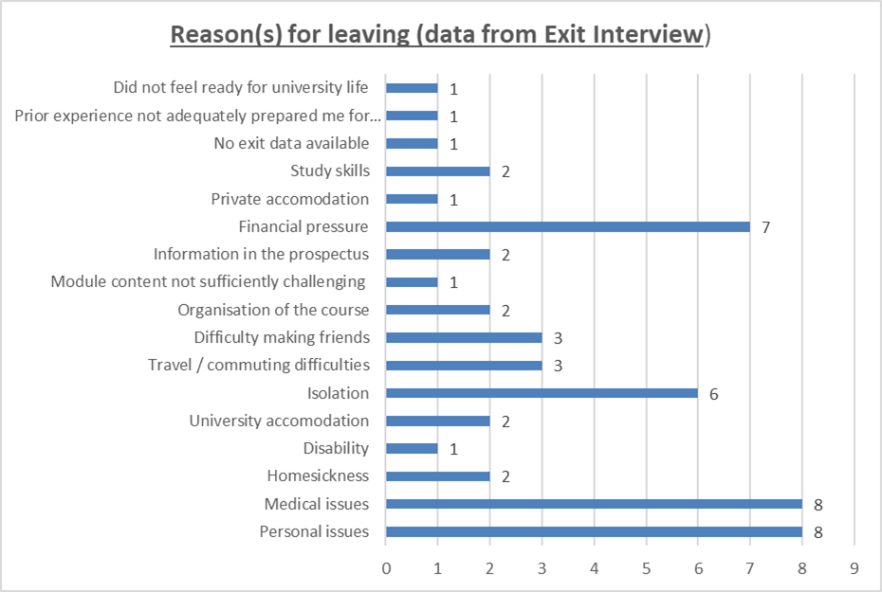
Notes:
As you can see, financial pressure, isolation, medical and personal issues are the pertinent reasons for these students leaving the university. The next few slides are quotes from these students.

Slide 7
“In my first year, I was a member of the Mature student society, Christian society, Howard league society and the Dance society. Mature soc didn't manage to meet much, Never had any correspondence from the Howard society. The Christian society was also not really helpful either and had to cease dance due to health conditions This year I haven't bothered joining any society at all.”
“We’ve lost a few from my course for one reason or another; they were all mature students”.
“I often spend breaks between lectures alone.”
“I don’t know what goes on and I feel like I don’t know it [the Uni] anymore”
“My house is in XXXX right by the main campus, even when I’m there I still don’t feel part of the university”
“I just don’t feel part of the Uni anymore”

Slide 8
“There is no specific meeting place, for example, a mature student lounge or common room where we can relax and chat. I feel this would give more opportunity to meet up with fellow mature students and have social interaction.”
“I think to classify 2/3 generations of people as one group is very remiss of the university, as each age group comes with differing needs and problems. I believe a three-tier system would be more appropriate”
“Staff awareness training, including tips for lecturing and assisting mature students in their learning – for example, encouraging lecturers and tutors to draw on the life experience of mature students.”
“Access to funding should the need arise due to job commitments or help around childcare”
“A mature student orientation at the start of orientation week to assist in forming peer networks/support amongst mature-aged students”
Notes:
This Mature Student Support was really effective in connecting the issues with engagement, the impact and the student perspective so it was written up as a report which is available for you to read.
I will now talk briefly about a current project I am looking at regarding ‘reading lists’.

Slide 9
The Reading List Project 2021 - 2022
SEO
Library Services
Dr Garner
Different Faculties
Students
Programme leaders
Lecturers
Ann Cooke
Notes:
The reason I wanted to look at reading lists was after being denied a resource by the DSA with them claiming it was not on the ‘reading list’ which is was, the list was just termed differently. So I decided to look at the background of reading lists, who complies them, who names them, where they are located and how often they are updated.
Upon doing so, I learned that there are several terms being used to represent a reading list which could explain the confusion for students claiming text books whilst claiming from their DSA fund.

Slide 10
Reading list
Key references
Key texts
Further reading
Recommended reading list
Bibliography
Selected bibliography
Modular descriptor reading list
8
Notes:
As you can see the university (or the faculties) are using 8 different terms for a reading list which has and could cause confusion not just for DSA students but for non-DSA students. It could also cause confusion for potential students who can view the modular descriptors online. For example, that student may start to claim or purchase these resources only to find out that are not on the course reading list.
Next slide: Originally it was just myself as an SEO researching this, however I was then contacted by Library Services who had also picked up on this issue and now they are several people involved in this project.

Slide 11
Previous projects by the SEO team:
Feedback benchmarking
FECS enquiry into a high failure rate of a modular assessment.
Learning, Teaching and Assessment Practices
Citizen Student Strategy
International students
The Study Skills Project

Slide 12
Opportunities through the SEO role:
Transferable skills
Published a journal article
Board members

