Slide 1
RAISE Spring Webinar: Attendance, Engagement and Learning
Hosted by Jill LeBihan and Rachel Forsyth (RAISE Network committee)

Slide 2
The Learning Journey on a Bike that Goes Nowhere
Notes:
The Covid story – lockdown, but also too cold and dark to go out on the road. Too much street harassment for a Granny cyclist. But being part of a new online way of learning and of building community was an important learning curve for me, because I'd never done it before. Just for reference, I did some other online learning things (DuoLingo; choir during Covid; a Microsoft Office Certification). I also have co-delivered some online and f-2-f learning as a visiting fellow at the University of Winchester (block delivery some hybrid stuff, some online stuff … the full mix). Those experiences, good and bad, are really important for those of us trying to deliver the new mix in the post-Covid world.

Slide 3
What can Peloton tell us about student engagement?
Timetabling
Asynchronous and synchronous presence
Building and supporting group identity
The motivational group
The motivational teacher
Notes:
Think about the last time you registered for an event/meeting that was in-person, and then you said you couldn't go (whatever reason, real or not) and you said you would catch up with the recording. Did you??

Slide 4
Just like any VLE

Slide 5
Just like any timetable

Slide 6
The power of the High Five

Slide 7
Being in class, in person

Slide 8
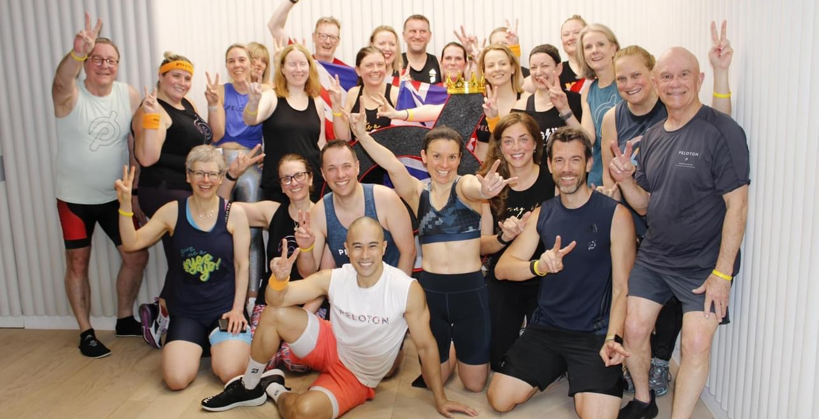

Slide 9
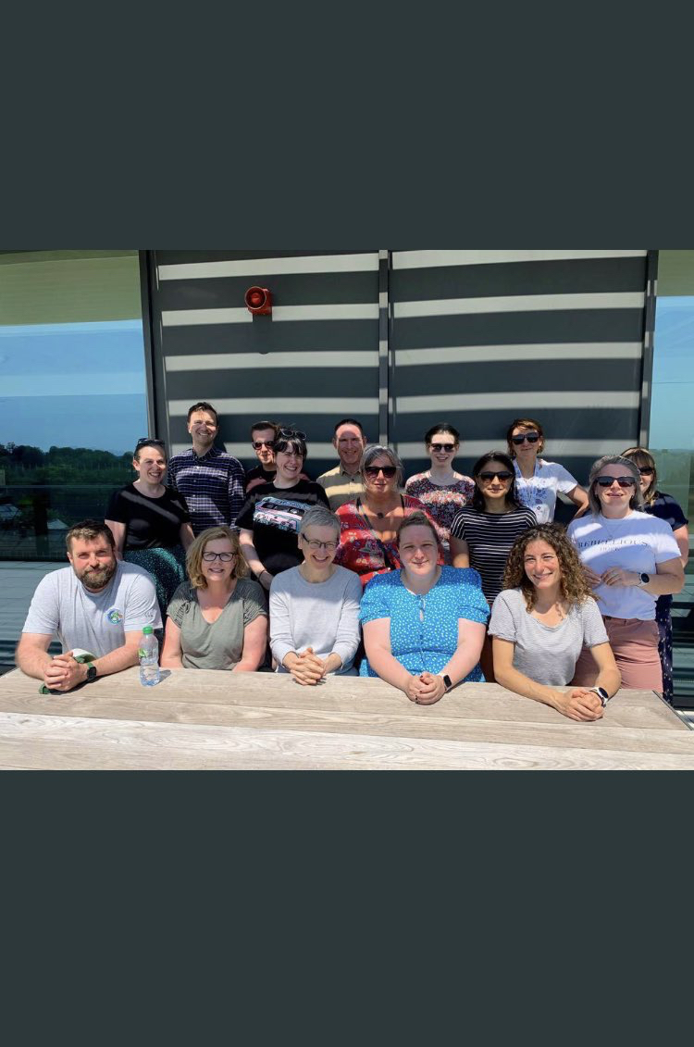
Another class photo
Not Peloton!
Notes:
The importance of building the class cohort at the beginning: a residential or consolidated team-building activity. Don't waste this opportunity on give them academic misconduct lessons!!!

Slide 10
The teacher and the student
Notes:
The power of mattering – of being recognised by your tutor – is a very powerful motivator, and managing that both digitally and IRL is important. Getting a digital 'high five' from the teacher when you are doing an asynchronous class is incredibly motivating, and the live class shout-out when they mention you individually also really matters. We say this is not possible with 'massification' but frequently these classes have 300 people in them live (more for the US instructors).

Slide 11
Emily Nordmann
Watch Party Guidelines
Emily Nordmann, Jacqui Hutchison & Jill R. D. MacKay (2022) Lecture rapture: the place and case for lectures in the new normal, Teaching in Higher Education, 27:5, 709-716, DOI: 10.1080/13562517.2021.2015755
"there must be acknowledgement that lectures can be more than their lowest form and that knowledge transmission is not the only outcome of importance; providing structure, community, and a sense of belonging is just as vital" (Nordmann et al, 2022, p.713)
Notes:
Explain Nordmann's watchparty model, and some of her findings – and crucially, that scheduling the 'Encore' version has an impact on student community.
https://eprints.gla.ac.uk/260094/1/260094.pdf
'there must be acknowledgement that lectures can be more than their lowest form and that knowledge transmission is not the only outcome of importance; providing structure, community, and a sense of belonging is just as vital'

Slide 12
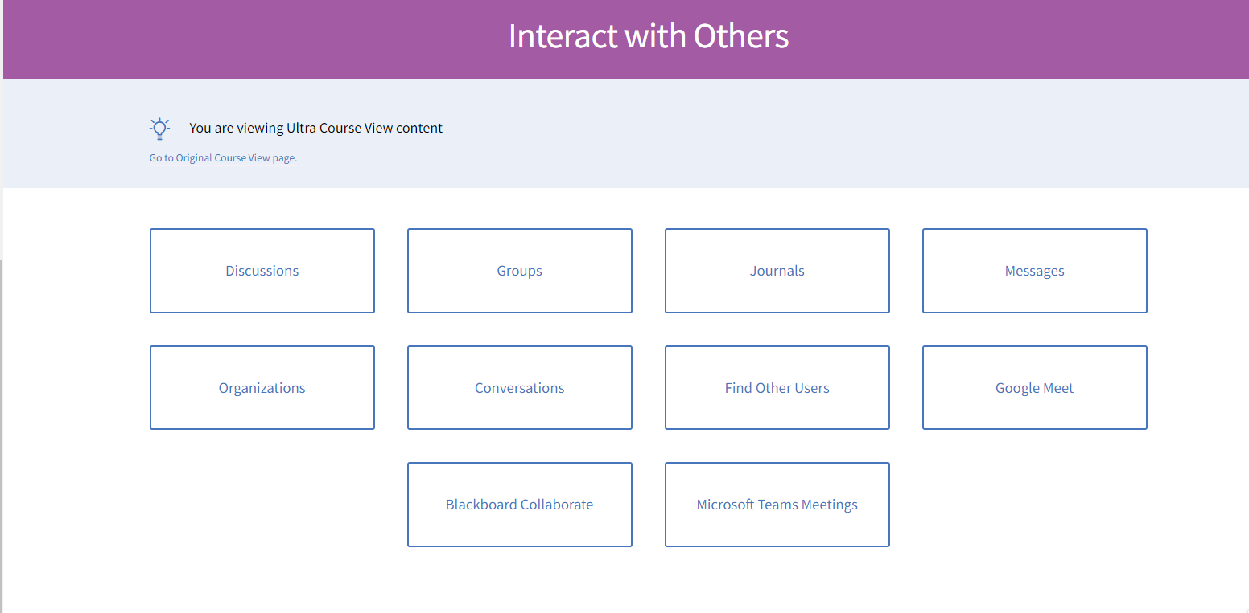
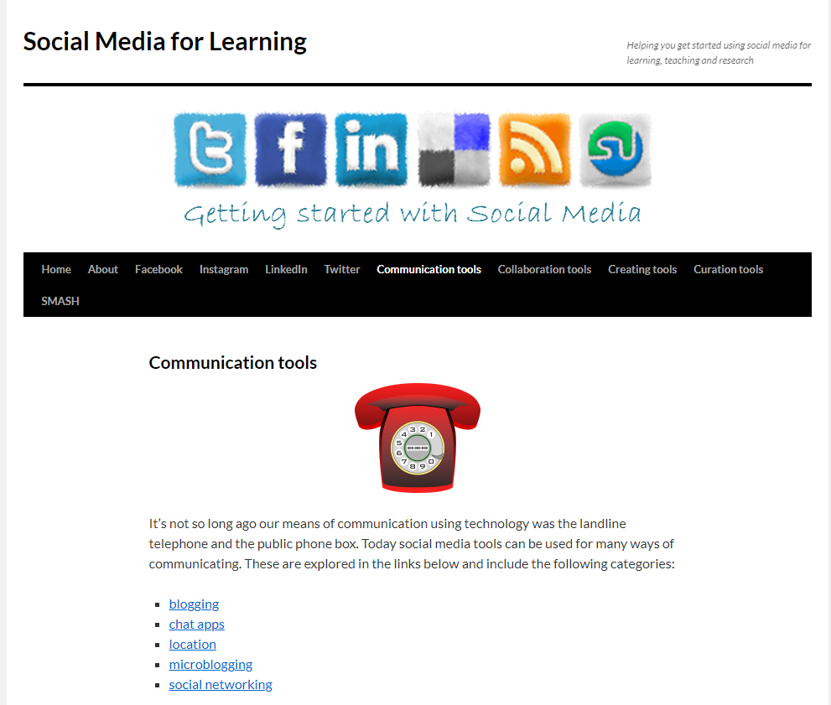
Social media plus the VLE
Blackboard Ultra
Social Media for Learning
Notes:
VLEs need to be places where students are willing to spend a bit of time, but they have been pretty slow to adapt. Students use wrap-around communications. I'm not sure if Teams is going to be the gamechanger in this space, with the chat options alongside video conferencing and resource sharing. But I do from time to time see screenshots of WhatsApp groups as well, and maybe we are well out of that as tutors ...

Slide 13
'Study with me' videos
Notes:
This is a whole genre, and you can pick music, ambience, and whether it is 'first' or 'third' person. But this is also a study group that can be live and which people might do together (IRL or online).

Slide 14
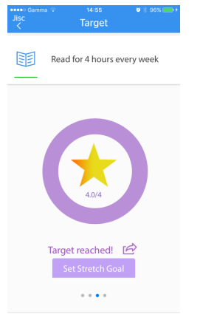
Gamification/Learner Analytics
Some discussion questions:
What's the difference between gamification and learner analytics?
What makes it worth attending?
Can we do better at building and supporting the online community, so that they encourage one another to come to class in person?

Slide 15
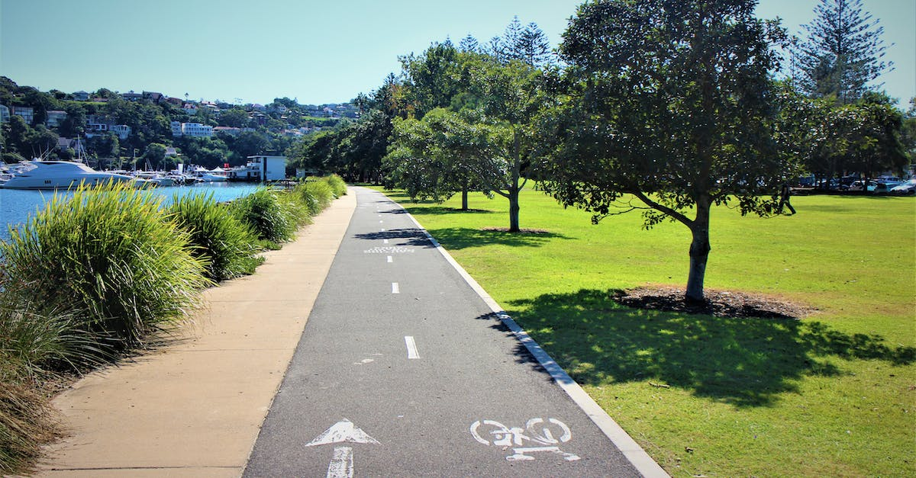
From the full class to the empty one
From static bikes to desire paths

Slide 16
Screenshot taken from Twitter, account of @PeteOlusoga, thread posted 22 December 2022

Slide 17
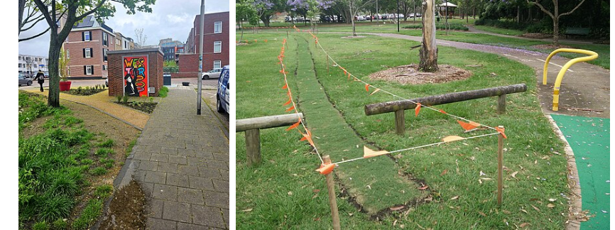
Desire paths: Karen Ray Costa (2022)
“It seems though, that much of #HigherEd is sitting over on the paved path, wondering why students aren’t showing up. Students are showing up, just not in the ways that we want. They’re showing us very clearly that our paved path doesn’t work for them.”
Images from Wikipedia, CC Licensed

Slide 18
Karen and Pete both point out that…
The teaching system is often rigid (credit sizes, dispersed timetables, inflexibility to life situations, inattention to previous learning and experiences)
Many students have extensive work commitments
The pandemic has affected students’ motivations, socialisation, mindsets, capabilities and capacities
Image: courtesy of Lund University

Slide 19
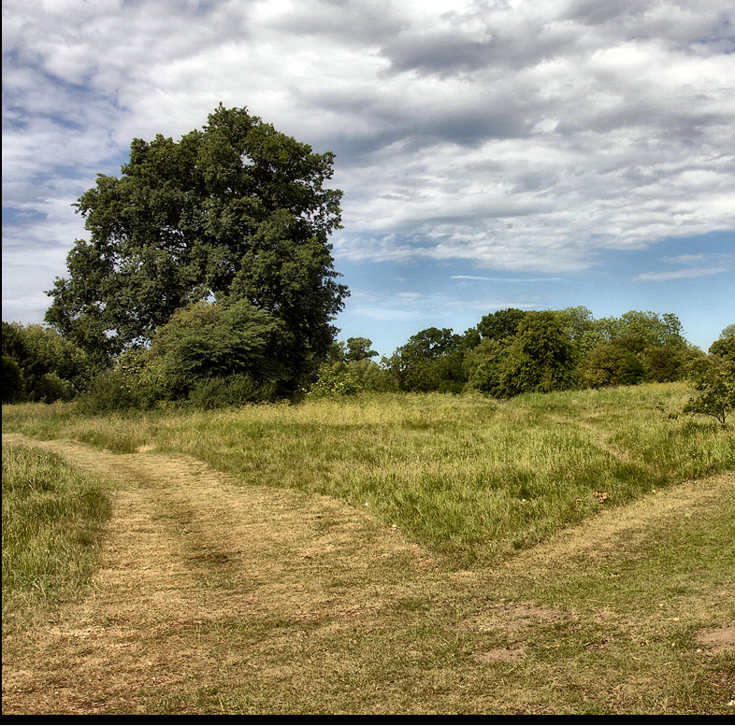
Prompt question: What are students’ ‘desire paths’ in relation to teaching?
Elements of choice in curriculum and assessment?
Flexibility of attendance? Or compulsory attendance?
Automatic option to have recorded lectures, or hyflex teaching?
Stronger incentive to attend? What could that be?
Image: pathways_by_Pat_Dalton_cc_licensed_on_Flickr

Slide 20
https://www.raise-network.com/conference-2023
Notes:
https://www.raise-network.com/conference-2023

