Slide 1
Impactful student partnerships RAISE Partnership Special Interest Group
Wendy Garner, University of Chester
Peggy Murphy, Liverpool John Moores University
Phil Carey, Liverpool John Moores University

Slide 2
housekeeping
Please mute to avoid background noise
Recorded:
Available after the event
Mute and turn off camera if necessary
Chat will be available too

Slide 3
structure
Two short presentations on student partnerships.
Kerry O’Hare, University of Chester.
Helena Gosling, LJMU.
Q&A
Breakout discussions
Action for authentic and meaningful partnership?
Feedback
Focus on Action

Slide 4
Kerry O’Hare
Student Engagement Officer 2012 - 2022

Slide 5
Issues affecting engagement with their studies, union societies, student support or the wider university life
How this lack of engagement is impacting upon the student.
What is the student’s perspective on this issue, what could be done differently?

Slide 6
The Mature Student Project 2018
WHY: I am a mature student myself. I am aware of certain support services within the university; however I am also aware that I have been ‘forgotten’ as a mature student. Why are certain mature students not targeted by the Mature Student Society? I would like to see if we can stop students ‘falling through the net’.
AIMS: This project has two aims
Gather from the mature students how they feel about being a ‘mature student’ and the positives and negatives of their experiences and whether they are aware of certain support services.
The second is to see if these services are functioning correctly and if not, how can we fix this so students are not feeling ‘isolated’ nor a ‘part of the university’.

Slide 7
Data collection
Locate the mature students who had left the university within their first year The university classifies a ‘mature’ student as anyone aged over 21.
There was 16 students who had terminated their studies from September 2017.There was 9 males and 7 females aged between 21 and 59 studying a variety of degree courses at level 4.
Literature review, Survey Monkey, interviews. Registry exit data, disability codes, polar data and the social media Facebook page.

Slide 8
Data collection
Facebook group discussion with mature students to determine the following:
➢ First term experiences of being a mature student
➢ Whether they are aware of support
➢ Whether they feel supported
➢ Whether they were acknowledged as a mature student or felt overlooked
➢ Whether they received any communication from the university
➢ Any suggestions they would like to propose to ensure the ‘Mature Student Experience’ is improved.
➢ Opinions about the label ‘mature student’.

Slide 9
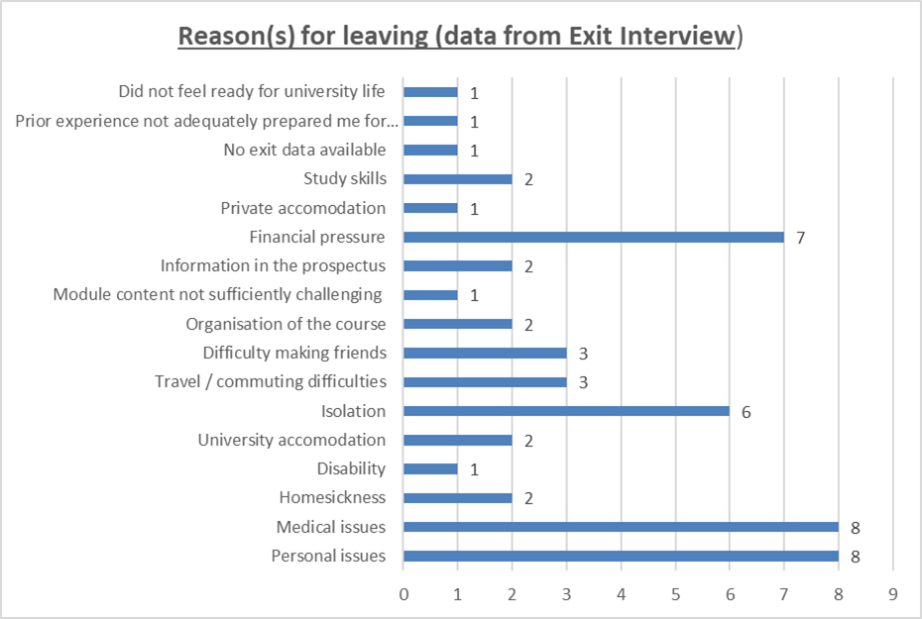
Notes:
As you can see, financial pressure, isolation, medical and personal issues are the pertinent reasons for these students leaving the university. The next few slides are quotes from these students.

Slide 10
Opportunities through the SEO role:
Transferable skills
Published a journal article
Board members

Slide 11
“In my first year, I was a member of the Mature student society, Christian society, Howard league society and the Dance society. Mature soc didn't manage to meet much, Never had any correspondence from the Howard society. The Christian society was also not really helpful either and had to cease dance due to health conditions This year I haven't bothered joining any society at all.”
“We’ve lost a few from my course for one reason or another; they were all mature students”.
“I often spend breaks between lectures alone.”
“I don’t know what goes on and I feel like I don’t know it [the Uni] anymore”
“My house is in XXXX right by the main campus, even when I’m there I still don’t feel part of the university”
“I just don’t feel part of the Uni anymore”

Slide 12
“I am currently in my second year in Uni, I am enjoying it but have found it difficult in some ways. I have found it very difficult to access appropriate pastoral and well-being support there doesn't seem to be a great deal of provision for Mature students”.
“Isolation is an issue and with respect, part of the problem is that all students over 21 are considered mature, such a broad spectrum of ages come with a broader spectrum of problems and University is stilled arranged around the wants and needs of young students living away from home”
“I’m starting to get behind. I’m not very motivated and I don’t feel part of the Uni. But somehow, I just keep going”
“It took me 3/4 months to get a telephone appointment with wellbeing”
“I’m at Master’s level and in my undergraduate [degree] I was crying for most of the first term.
“I just don’t know what’s going on [within] campus anymore”
Notes:
After the students provided these answers, they were then asked how the university could help and support mature students going forward. The next slide provides some examples of what the students suggested.

Slide 13
“There is no specific meeting place, for example, a mature student lounge or common room where we can relax and chat. I feel this would give more opportunity to meet up with fellow mature students and have social interaction.”
“I think to classify 2/3 generations of people as one group is very remiss of the university, as each age group comes with differing needs and problems. I believe a three-tier system would be more appropriate”
“Staff awareness training, including tips for lecturing and assisting mature students in their learning – for example, encouraging lecturers and tutors to draw on the life experience of mature students.”
“Access to funding should the need arise due to job commitments or help around childcare”
“A mature student orientation at the start of orientation week to assist in forming peer networks/support amongst mature-aged students”
Notes:
This Mature Student Support was really effective in connecting the issues with engagement, the impact and the student perspective so it was written up as a report which is available for you to read.
I will now talk briefly about a current project I am looking at regarding ‘reading lists’.

Slide 14
Building impactful partnerships with students who have a criminal record Helena Gosling, LJMU

Slide 15
Pedagogy, practice & partnership

Slide 16
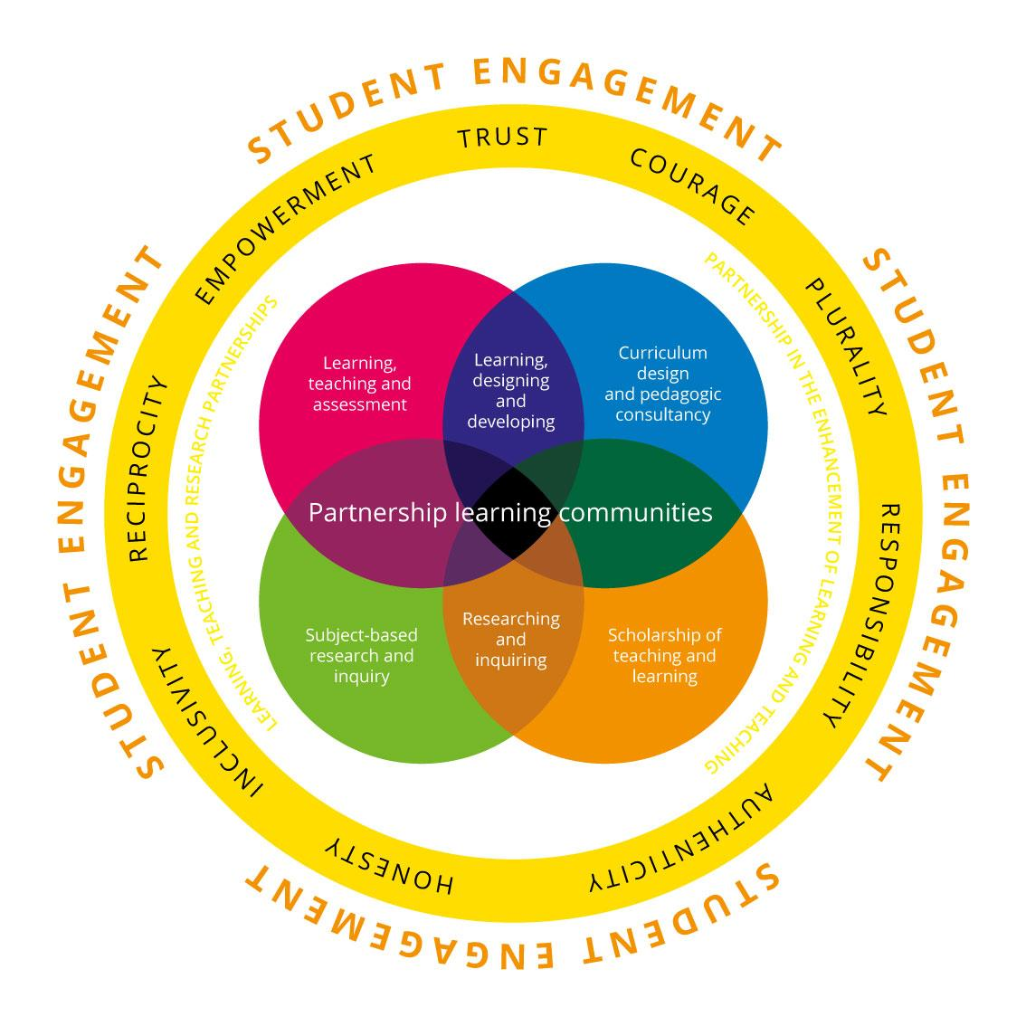

Slide 17
Building partnerships through storytelling
A creative activity that facilitates a pedagogy of compassion amongst and between students, enhancing understanding of people and their experiences beyond the classroom
Why stories?
Disruption and connection:
‘The debate moved onto how children follow in the footsteps of their parents with history of criminal behaviour, with some sharing how their children have gone down the same road that they did and they find it difficult to steer them away from crime and so blame themselves. This is something I feel passionately about, coming from a deprived background with a parent who was in and out of prison in my early years, not only effected by early school years but as I got older I realised that was not the sort of behaviour I wanted to maintain’

Slide 18
Concluding comments: listen, learn, lead
https://journals.sagepub.com/doi/10.1177/0264550520914377

Slide 19
Breakout room discussion
Consider:
How student:staff initiatives drive and inform change?
The challenges associated with authentic and meaningful partnership?
Actions can institutions and individuals take to create an environment where partnership can flourish?
Please note responses on Padlet - https://padlet.com/WendyGarner/d7jhr1loy85rzudm
Feedback to group will focus on actions

Slide 20
THANK YOU

